Slide 1
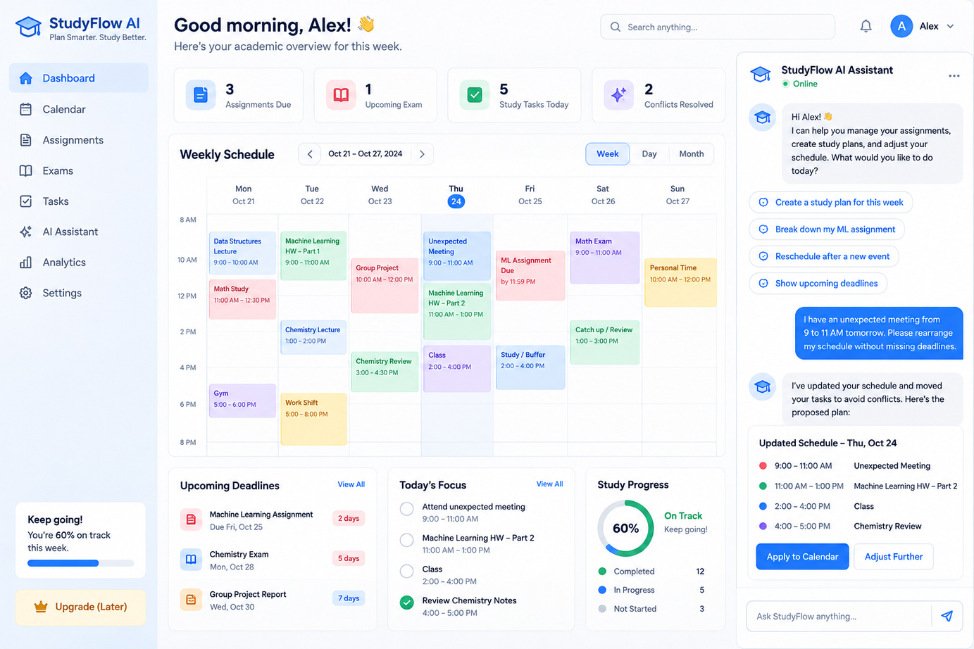
Agentic AI Hackathon Project
StudyFlow AI
An adaptive academic planning assistant that helps students organize assignments, generate study plans, and recover when schedules change.
Assignments
Tasks
Scheduling
Replanning
Plan smarter. Study better.
Team StudyFlow AI
StudyFlow AI
01

Slide 2
THE PROBLEM
Students do not just need reminders. They need a plan that stays useful when life changes.
“ I know what is due. I just do not know when to do it, how long it will take, or how to recover when my day gets disrupted. ”
This is the real academic planning problem we want to solve.
StudyFlow AI
02

Slide 3
WHY IT MATTERS
Academic planning breaks in three predictable ways.
Fragmented deadlines
Planning overhead
Unexpected disruptions
Assignments, exams, classes, and personal commitments live across different tools and become hard to manage.
Students must estimate effort, break down work, and choose priorities before they even begin studying.
A missed study block or a new meeting can make a carefully built plan obsolete.
1
A planner that cannot adapt creates more stress instead of reducing it.
problem space
StudyFlow AI
03

Slide 4
THE SOLUTION
StudyFlow AI turns academic responsibilities into an executable weekly plan.
The output
Students add their assignments, exams, and fixed commitments. StudyFlow AI breaks work into smaller tasks, creates study blocks, checks feasibility, and replans when something changes.
A practical weekly plan
not just an AI to-do list.
StudyFlow AI
05

Slide 5
WORKFLOW
From academic chaos to a clear plan in three steps.
1. Capture
2. Plan
3. Adapt
Add assignments, exams, deadlines, classes, and other fixed events.
→
Generate tasks, estimate effort, and create study blocks around available time.
→
If the week changes, revise the schedule and ask the student for approval.
StudyFlow AI
05

Slide 6
WHY AGENTIC AI
A static scheduler can organize time. An agentic system can reason, react, and recover.
Traditional planner
StudyFlow AI
• Stores deadlines
• Creates reminders
• May generate a schedule once
• Breaks when the student misses time
• Leaves replanning to the user
• Interprets natural-language requests
• Breaks assignments into tasks
• Uses scheduling tools and validation
• Detects conflicts and repairs plans
• Requests approval before changes
Core idea: intelligence is not just in generating a plan — it is in deciding what to do next when that plan fails.
StudyFlow AI
06

Slide 7
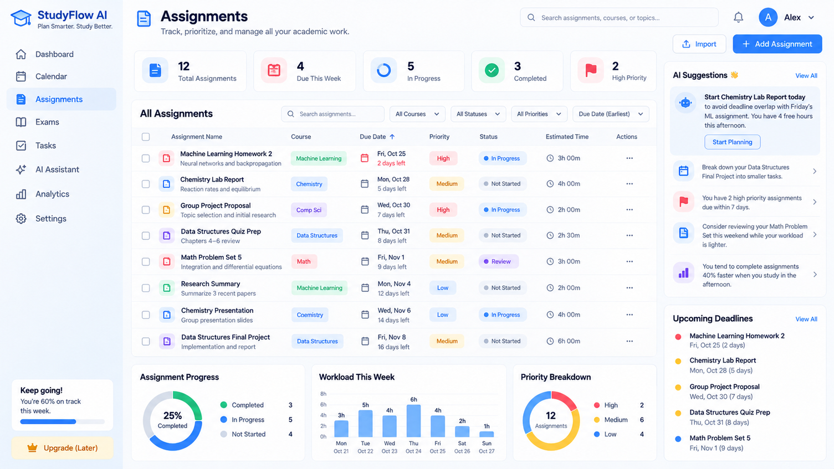
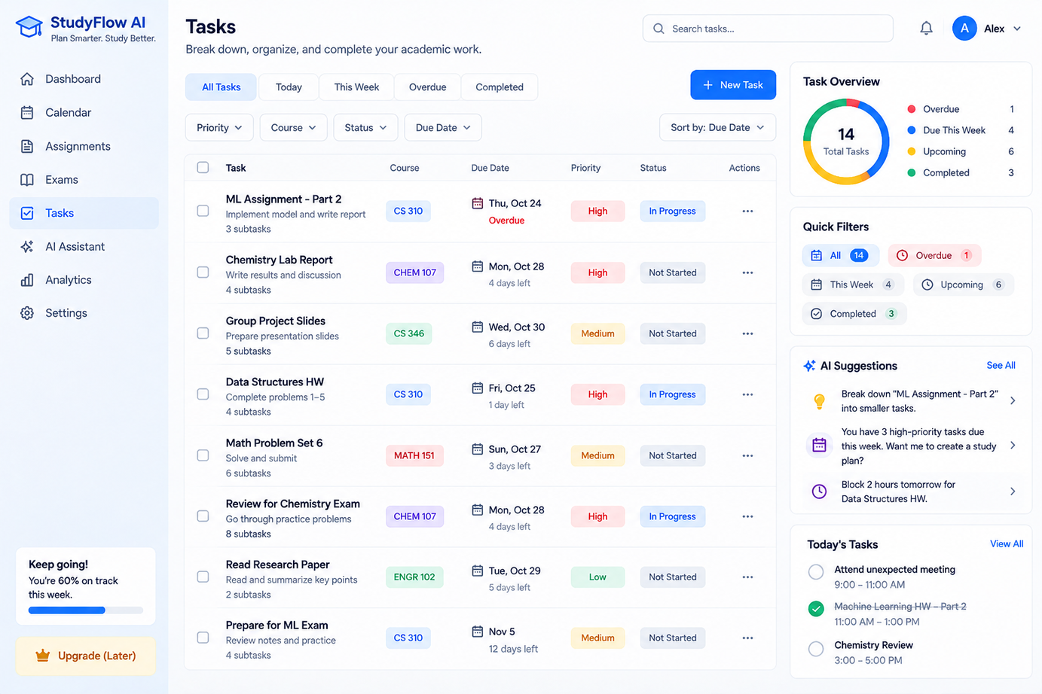
PRODUCT SURFACES
StudyFlow AI is designed as a complete academic planning workspace.
Dashboard
Assignments
Tasks
Calendar + AI
Weekly overview, schedule, deadlines, and AI assistant.
Track due dates, priorities, status, and estimated effort.
Manage subtasks, progress, and focused study actions.
Generate plans and replan after disruptions.
StudyFlow AI
07

Slide 8
UI CONCEPT
A clean student-facing experience focused on clarity, action, and confidence.
Dashboard
Weekly calendar, focus tasks, progress, and AI guidance.
StudyFlow AI
08

Slide 9
PRODUCT SURFACES
StudyFlow AI is designed as a complete academic planning workspace.
Assignments
Track due dates, priorities, status, and estimated effort.
StudyFlow AI
07

Slide 10
PRODUCT SURFACES
StudyFlow AI is designed as a complete academic planning workspace.
Tasks
Manage subtasks, progress, and focused study actions.
StudyFlow AI
07

Slide 11
LIVE DEMO STORY
The strongest moment in the demo is when the schedule repairs itself.
Student says: “I have an unexpected meeting tomorrow from 9 AM to 11 AM. Rearrange my schedule without missing deadlines.”
Before
After
9–11 AM ML homework
11–12 PM Chemistry review
1–3 PM Class (fixed)
3–4 PM Available
4–5 PM Available
9–11 AM Unexpected meeting
11–1 PM ML homework – part 2
1–3 PM Class (fixed)
3–4 PM Chemistry review
4–5 PM Study buffer
Result: the plan adapts, constraints are preserved, and the student stays in control through approval.
StudyFlow AI
09

Slide 12
SYSTEM ARCHITECTURE
StudyFlow AI combines agents, deterministic scheduling logic, and a student-facing web app.
Frontend
React + TypeScript + Tailwind UI for Dashboard, Assignments, Tasks, Calendar, and AI Assistant
Supervisor
Task Planning
Scheduling
Replanning
Validation
Routes requests
Breaks down work
Allocates study time
Repairs schedules
Checks feasibility
Backend + Data
FastAPI • LangGraph • SQLite • scheduling tools • approval state • activity logs
StudyFlow AI
10

Slide 13
WHAT MAKES STUDYFLOW SPECIAL?
It is not just a planner. It is a planning system that can explain and repair decisions.
End-to-end flow
Human-in-the-loop
Observable AI
Assignment → task → calendar → replanning
All meaningful schedule edits are reviewed before they are applied
Students can see agent activity, proposed changes, and reasons
StudyFlow AI
10

Slide 14
FUTURE VISION
StudyFlow AI can grow into a truly personalized academic operating system.
Near-term extensions
Smarter personalization
Longer-term direction
Google Calendar sync
Canvas integration
Reminders and notifications
Preferred study times
Task-duration learning
Adaptive workload balancing
Performance insights
Semester planning
More advanced student support agents
Vision: help students spend less time planning and more time actually learning.
StudyFlow AI
14

Slide 15
Thank you
StudyFlow AI
Questions?
Helping students turn deadlines into realistic action.
Paul English Applied AI Institute • UMass Boston
StudyFlow AI
15

Slide 16





Team Kanyarashi
Sankalp Vaish
Surya Sudhamshu Parvataneni
Sumukh Veeramalla
Rishank Singh
Krish Gopani
StudyFlow AI
Paul English Applied AI Institute • UMass Boston
15

